Slide 1
Who cares for whom?
Rural ageing, migration and networks of informal care
Alasdair Rutherford
Centre for Population Change
University of Stirling

Slide 2
Motivation
A substantial proportion of the population engage in informal caring, with more than 40% providing informal care for at least one year over a twenty year period (Heitmueller, Michaud 2006).
With an aging population, and greater pressures on the public purse, the role of informal carers in providing essential care services alongside the state is increasingly important.

Slide 3
Informal caring is complex
Notes:
It is much more than just 1-1; it varies in intensity, frequency, quality and reliability; it may be a complement or a substitute for formal care; it may meet the needs of the caree, or not; it may not be perceived as care, or may be defined differently by carer and caree; it may be reciprocal, or part of a more complex network of support; it may be inside or outside the house, and from family, neighbours or friends; carers may be general, specific, or there in a crisis; it may be visible or invisible; it may be appreciated or resented, gladly or grudgingly given.
As such, any attempt to pin it down will only capture part of the story. Our mixed methods approach attempts to triangulate informal care, and explore its characteristics in more depth.

Slide 4
Approach :: Mixed Methods
Quantitative Study: Analysis of Secondary Data
  Who cares?
  Networks of informal care
  Migration and informal care
Qualitative Study: Interviews with Older People and Informal Carers
  How are decisions made regarding informal care?
  How do these decisions interact with decisions regarding migration?
Notes:
Something for everyone, but does affect the depth in which I can go into my methods – happy to discuss these further with anyone who is interested.

Slide 5
Quantitative Methods
In this project we have used data from the British Household Panel Survey (BHPS); the Family Resources Survey (FRS) and the English Longitudinal Study of Aging (ELSA).
This presentation uses BHPS data, analysed both longitudinally and cross-sectionally, using OLS, logistic regression, ordered logits and 3-stage least squares.

Slide 6
Qualitative methods
Two fieldwork locations
ANGUS: Semi-structured interviews with 20 older peoples’ households; Semi-structured interviews with informal carers
NORTHUMBERLAND: 9 focus groups with older people and 2 with informal carers
Analysis of transcripts to identify themes.

Slide 7
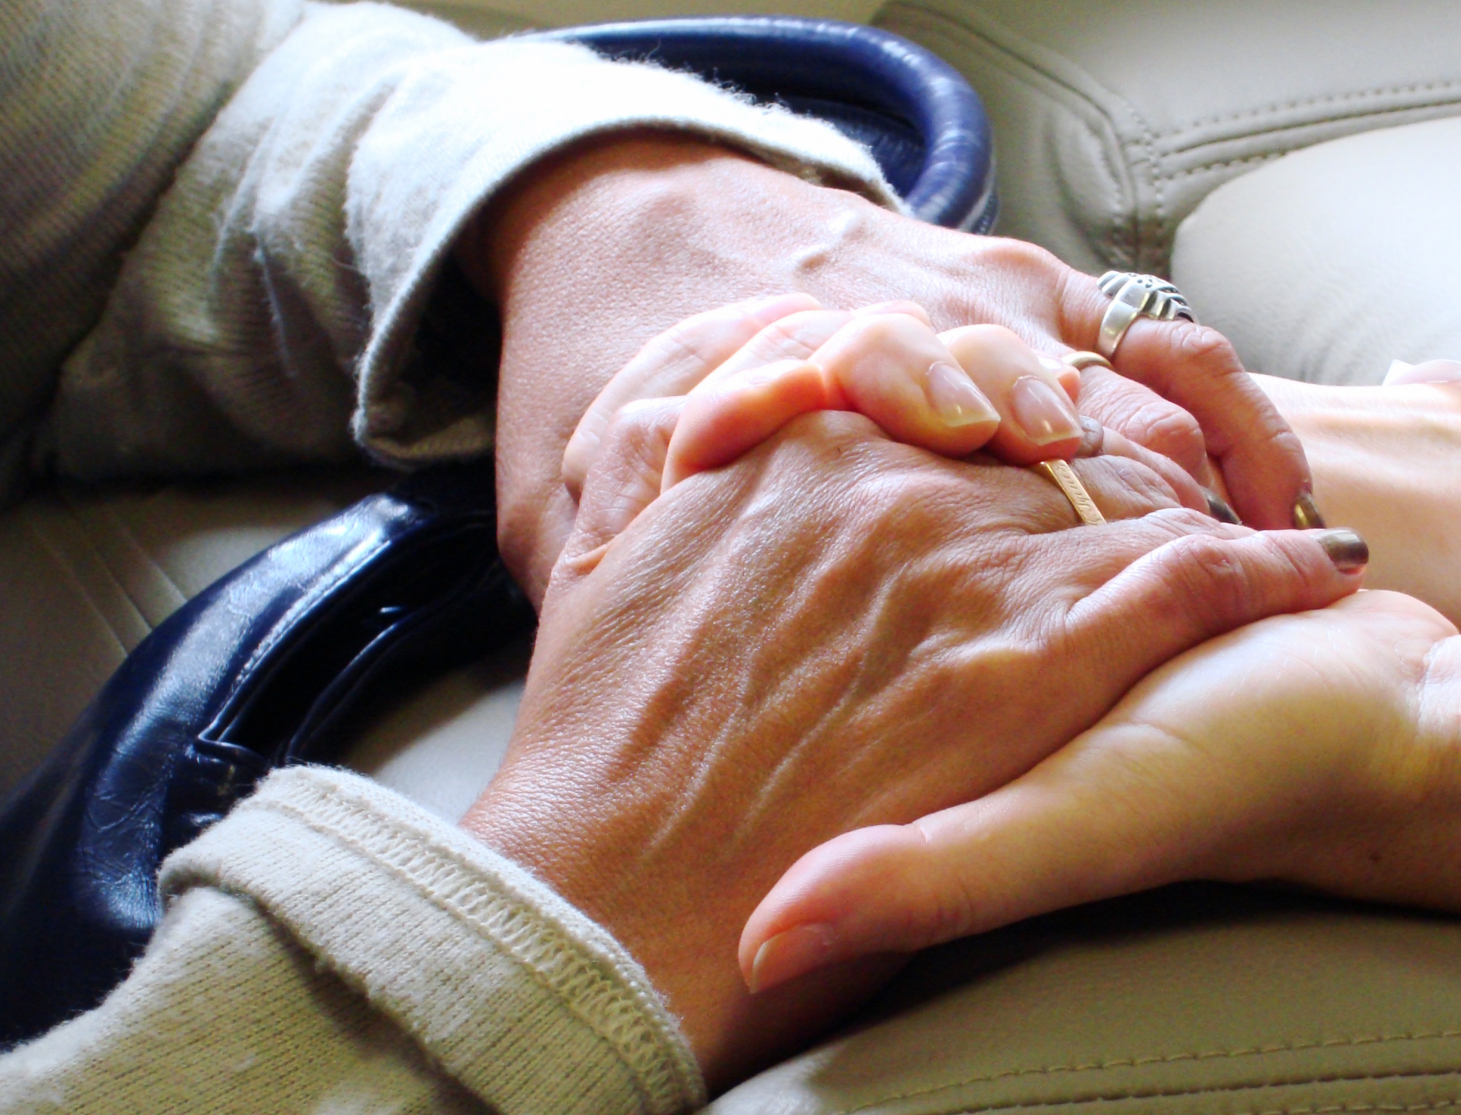
Describing Informal Care

Slide 8
What is informal care?
Captured in the BHPS by asking:
“Is there anyone living with you who is sick, disabled or elderly whom you look after or give special help to?”
“Do you provide some regular service or help for any sick, disabled or elderly person not living with you?”

Slide 9
Providing Informal Care
Women
Men

Slide 10
Receiving Informal Care
Men
Women

Slide 11
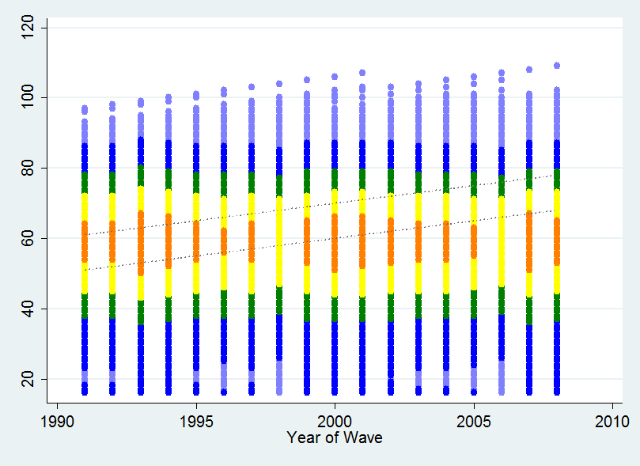
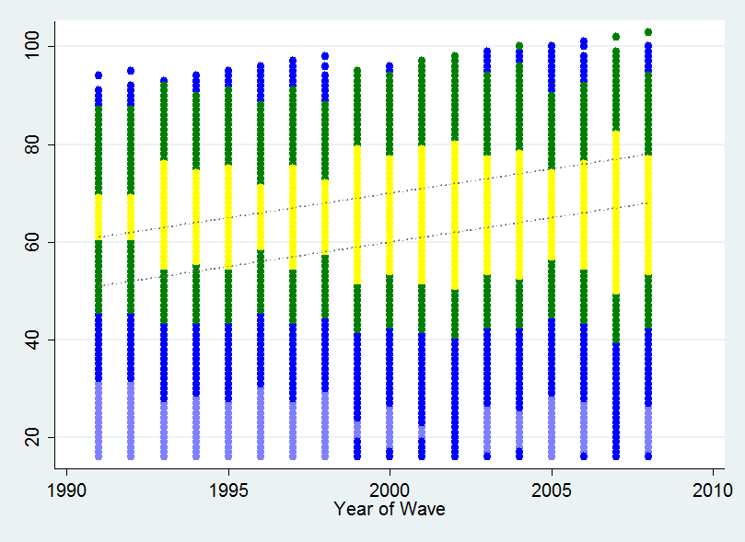
Informal care giving and age
Female Male
Notes:
FEMALE MALE
Women are more likely to provide informal care than men. They also provide care at a younger age.
Men (if they are alive) are more likely to continue providing care into older age
[Graphs produced with logit of caring probability on age to 4 powers, probabilities predicted by year and age, and mean probabilities plotted]

Slide 12
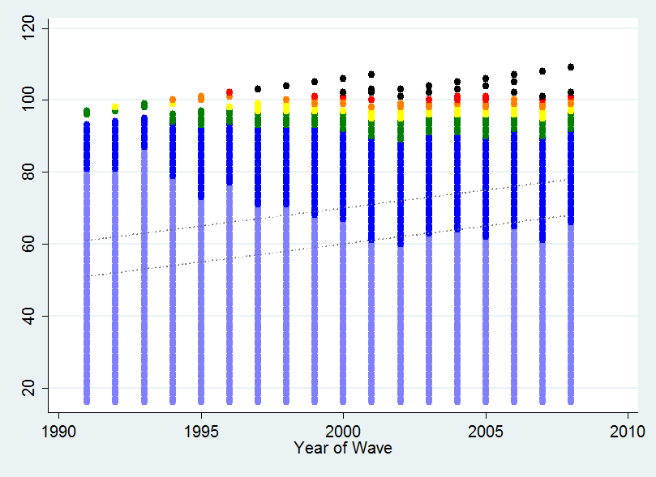
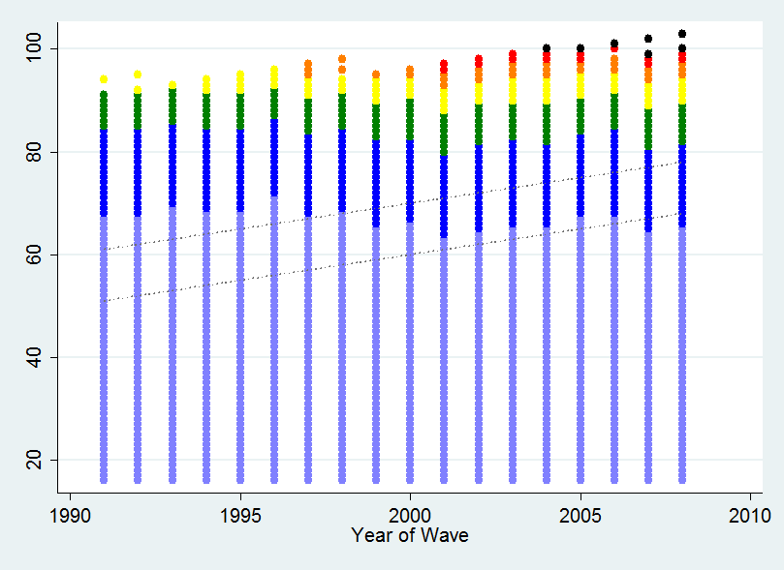
Informal care receipt and age
Female Male
Notes:
FEMALE MALE
Men more likely to receive care, and later in life than women. Care receipt for women is getting earlier, and lasting longer for men.

Slide 13
Population figures for Carees by care source

Slide 14



Adults Aged Over 55 Years in 2006
2.33% Financial Support from Children
40.6% Help from Children
55% Children Visit at least 1 per week
8.4% Formal Welfare Services
12% Hospital Stay
6.3% Care from Spouse
1.4% Care from Child(ren)
0.14% Care from Other Family
0.07% Care from Non-Family
20.5% Caring for Others
1% Both give and receive care
Notes:
help

Slide 15
Understanding unmet need is important
Notes:
The graphs for care receipt show only that care is being given – it does not include those in need who don’t receive support, or those who receive support in some areas but have unmet need in others.
Significant area – Jane’s paper
The CPC & Care Life Cycle paper in Population Trends discuses issues of defining and measuring unmet need using a number of data sets. They show significant levels of unmet need, and found that ADL need is higher than IADL need.
We do not explore unmet need in such detail, and have limited data in the BHPS. We measure need through reported ADLs and IADLs, but do not match specific needs to specific sources of help.

Slide 16
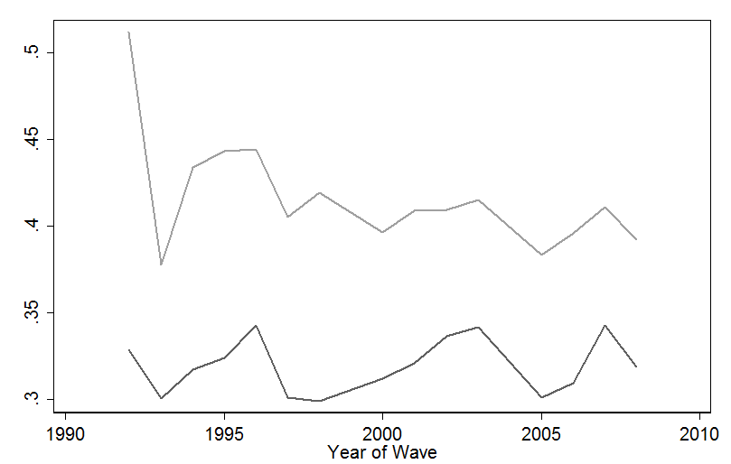
Caring Index: No. Care relationships per older person with need
Formal & informal care
Informal care

Slide 17
Modelling Care Complexity
We attempt to model care in the BHPS with four equations (2006 cross-section):
  Carer
  Caree
  Formal Care
  Help from children
We use a 3-stage least squares approach to try and control for the endogeneity of the joint decision making.

Slide 18
Estimation Results
Being a carer or caree does not affect the probability of you also becoming the other
Receiving formal care reduces the probability of receiving informal care inside the household (substitution), but does not affect the probability of receiving care from outside the household.
Receiving informal care inside the household increases the probability of receiving help from children outside. #

Slide 19
Caree Equations
 | Caree: OLS | Caree: 3SLS
carer | -0.00991 | 0.0567
 | (0.00624) | (0.0783)
formalcare | -0.0680 | -0.601
 | (0.0262)*** | (0.183)***
helpfrom_children | 0.00316 | -0.0440
 | (0.00658) | (0.0320)
female | -0.0100 | -0.00945
 | (0.00402)** | (0.00616)
N | 8,535 | 8,184
Other variables:
age, age², marital status, subjective health (2001), IADLs

Slide 20
Carer Equations
 | Carer: OLS | Carer: 3SLS
caree | -0.0355 | -0.0441
 | (0.0215)* | (0.0936)
formalcare | ✗ | ✗
helpfrom_children | ✗ | ✗
female | 0.0497 | 0.0537
 | (0.00760)*** | (0.00862)***
N | 8,535 | 8,184
Other variables:
age, age², marital status, subjective health (2001), Occupation (1990s),
Volunteering (1990s)

Slide 21
Help from children Equations
 | Children: OLS | Children: 3SLS
caree | 0.0294 | 0.159
 | (0.0215) | (0.0928)*
carer | ✗ | ✗
formalcare | 0.0452 | 0.423
 | (0.0309) | (0.261)
female | 0.0597 | 0.0610
 | (0.00696)*** | (0.00843)***
N | 8,535 | 8,184
Other variables:
age, age², marital status, IADLs, Household Income, Contact with children (2001),
Occupation (1990s)

Slide 22
| gender roles | breadth of support | fear of being a burden | lack of care planning | lack of information on care options | perception of family pressure |

Slide 23
Gender roles: Varied types of support
Interviewer: “What sort of things does [your daughter] do for you?”
AN04P: “She’ll perhaps make a bowl of soup […] and bring some down for us. This place we were supposed to be moving into, her husband decorated it from top to bottom.”

Slide 24
Gender roles: Types of support
AN05P: “My son-in-law’s terribly good to me, he just looks after all my affairs, looks after all my money, and whatever. […] He’s a great internet fella’, and he does my shopping on the internet for me.”

Slide 25
Gender roles: Sons and daughters
Interviewer: “Does your daughter provide some support?”
AN13P: “[My daughter] is in twice a week.”
“[…] my son, of course. He’s the one that’s in charge, if you ken what I mean. Then as I say, he’s a lot abroad. […] he was up last week, then he flew the next day to Dubai or somewhere.”

Slide 26
Gender roles: Sons and daughters
AN03P: “I started having wee health problems about three years ago, my wife looks after me to a great extent if you see what I mean.
We’ve got a son who actually lives around [nearby], but I wouldn’t ask him to help out because basically he’s got his own life to live.
I was born in a tradition where the daughters looked after the old timers […] I didn’t do that for my parents and I wouldn’t ask my son.”

Slide 27
Reluctance to be a burden
Interviewer: “If you and your wife did need more support in the future, would you consider moving to [the city] to be closer to your daughter?
AN10P: “That’s out of the question that, you know, your first attitude is, I’m not going to bother them, that’s your first … that would depend an awful lot on her making that decision, not me, no, I would be if it came to that, I don’t know, I’d be a bit of a coward, maybe backing off, you know. No, I wouldn’t look to them, I wouldn’t be saying ‘oh you’ve got to …’ ‘I’ve got to go down there, or you’ … no.”

Slide 28

Migration & informal care

Slide 29
First, the excuses …
Notes:
Location decisions of older people and their family are taken at different times, and for a number of factors. Location may be chosen to facillitate care, or care decisions may be driven by location decisions taken for other reasons.
Location may be chosen many years in advance of needing care, at retirement, and this may be done with or without considering care.
Older people may choose locations in order to provide care.
If there is a move for informal care reasons, it may be either the parents or the children who move.
Disability may make moves harder due to the effort of moving, or it may make them more necessary when living situations are unsustainable.
Data limitations mean that we have very few households where both parents and children are observed both before and after the move. Also, we only observe where a decision has been taken to provide care, and not where a decision has been made not to.

Slide 30
Movement
There is relatively little movement of older people: around 3.2% of adults aged >=65 move each year, compared to 8.3% of adults in the population.
There is no difference in moving rates between urban and rural areas.

Slide 31
Distance between parents and children
The distance between older parents and their children is greater for parents living in rural areas – this may have an impact of informal care provision.
BUT, distance is endogenous.
Notes:
We experiment with using lagged distance to parents, but the question is how much of a lag to use – when was the location decision made?

Slide 32
Reasons for moving
We explore whether the reasons given by respondents for moving are correlated with the distance they move.
We estimate an OLS equation of log distance on a number of explanatory variables for the sub-sample of adults who have moved between waves.

Slide 33
Average Distance of moves
ALL | From Urban | From Rural |  | MOVE IN | From Urban | From Rural
To Urban | 24.6 miles | 56.4 miles |  | To Urban | 31.2 miles | 59.0 miles
To Rural | 57.4 miles | 21.1 miles |  | To Rural | 40.9 miles | 8.6 miles
MOVE CLOSER | From Urban | From Rural
To Urban | 68.7 miles | 105.1 miles
To Rural | 128.0miles | 79.3 miles

Slide 34
Distance of move (log miles)
moveinwithfamily | 1.351
 | (0.416)***
movehealth | -0.0757
 | (0.219)
moveduetostairs | -0.891
 | (0.198)***
movecloserfamily | 2.387
 | (0.188)***
Urban >> rural | 1.757
 | (0.244)***
Rural >> urban | 1.003
 | (0.179)***
Rural >> rural | 0.759
 | (0.264)***
Sample of adults aged >=55 years
Other variables in regression but not reported here:
age, age², gender, region (L), IADLs (L), Hospital visits (L), formal care (L), caree (L)
Notes:
Sample of adults aged >=55
Younger people move further
Moving in with family increases distance
Health has no effect
Stairs reduces distance
The smallest distance is urban to urban; movements between urban and rural in either direction are further than between rural areas

Slide 35
| Proximity does not necessarily lead to care|
| Wealth makes a difference |
| Housing market issues |
| Strong attachment to place |
| Family pressure|
| Living together is hard |

Slide 36
Reasons for moving
AN03P: “We were looking for a house in Scotland rather than anything else. But because we kept coming back [to Angus] for holidays, these were the estate agents’ windows that we kept looking in.”
“We never even thought about services at all. […] The move wasn’t made for economic reasons at all, and […] there was more sentiment attached to it than anything else.”
Notes:
Family
Return to birthplace
Attachment to place

Slide 37
Pressure to move
Interviewer: You said the family was keen for you to move?
AN07P: “Oh aye, practically helped us to move. We wir’nae keen … we would have stuck for a few more years, I think.”
“[…] so of course [the family] took over. We were […] thrown out from our own home before we knew where we were.”
Notes:
“Well, because we were getting older and the stairs were beginning to be a bit of bother, right enough.”

Slide 38
Reluctance to move
Interviewer: “Did you ever consider when you retired moving somewhere else?”
AN18P: “No I like it here. [Children have stayed close] The only one that won’t move up here is my mother, and she is down there on her own and she will not move […] She’s feeling too old, […] she is 95 so. ‘I’ve lived here 50 year, that’s all I get, stop them getting on to me’, but she manages fine.”

Slide 39
Decisions to move
AN08C: “We did speak about [moving in]. […] No, he would not consider coming to stay with us. He’d rather be dead than have to depend on somebody.”
AN14P: “I would rather go with my family [than move into a care home]. […] [My daughter]’d have to move […] she has three rooms in her house. Well, we might manage.”
AN19P: “No, I make my own decisions, I never discuss any with [my children], they come to me. […] I’ve told them ‘there’s no way I’m coming to any of you’.”

Slide 40
Moves don’t always work out
AN11P: “I was married and then my husband died […] I wasn’t wanting to be on my own.”
Interviewer: “That was why you decided to move in with your nephew?”
AN11P: “Well they were in a bit of trouble […] that’s why I helped […] I sold my house so that it would help them get a house, combined.”
Interviewer: Do you think moving to [small town] was a good move?
AN11P: “Well sometimes it’s good, sometimes it’s bad. It’s a see-saw.”

Slide 41
Moves don’t always work out
Interviewer: “If you were feeling down […], who would you speak to?”
AN11P: “Well I suppose it would be [my nephew’s wife] if she was in, because she's usually out.”
Interviewer: “And [nephew and wife] are happy to help out?”
AN11P: “I wouldn't say [laughter].”
Interviewer: “Okay.”
AN11P: “That is in the balance just now actually.”

Slide 42
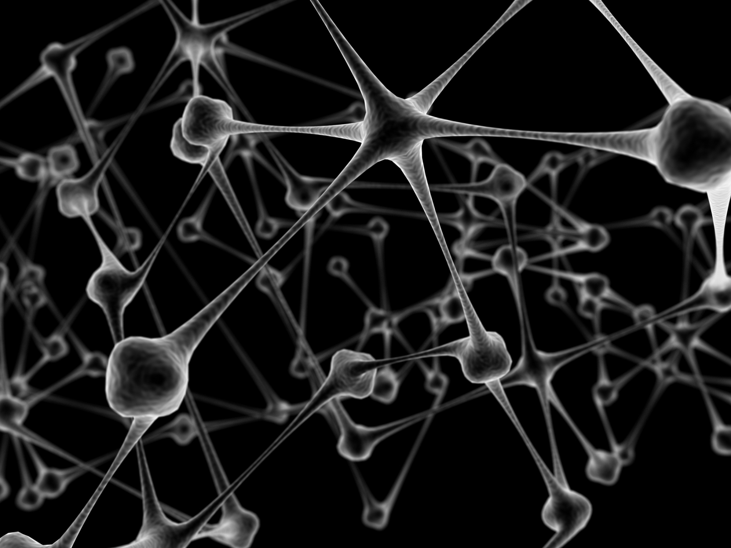
Building Care Networks

Slide 43
Building care networks
Matching informal caring relationships within the household allows us to build a dataset based on observations of relationships rather than individuals.
Formal social and health care can be added to this, as can help from outside the household.

Slide 44
The best thing about network analysis is the cool diagrams

Slide 46
Challenges
The BHPS has little data on informal care from outside the household
Incorporating care intensity
Incorporating need – and unmet need
Modelling change over time

Slide 47
| Social networks are important | Substitution |
| Grandparents and grandchildren | Care complexity | Costs of informal care |
Notes:
Forming social networks of support – connection to the local community is important. This can come from time spent there, but some people are better able to integrate than others. Age seems to be important – building links is easier if you move when you are younger.
Substitution between family and friends – there appears to be some substitution between networks of family and friends; those who have family closer by have smaller non-family social networks.

Slide 48
Complexity of care
AN19P: “I have a grand daughter that does come in and wash the entry and hoover for me but. And her big brother does my shopping, but takes me with him. […] Anything I need done my grandson does it for me.
My youngest daughter pops in to see me. My eldest daughter, I very rarely see her, but […] her husband was an invalid so she was looking after him. One son, I only see him maybe my birthday and Christmas but then again I know where he is.”

Slide 49
Social networks in local areas
AN02P: “I have very good neighbours. I like to think I can do without them.”
AN03P: “We’ve got neighbours who are close by, but I’m not exactly friendly with any of them […]. My closest neighbour we’ve got a sort of feud going with because […] he’s one of those anti-tree fanatics.”
AN04P: “Some [neighbours] I do [know]. But we’re not in and out of each other’s houses, like some other neighbours.”
AN05P: “I go to the church […] and they are very supportive”
AN17P: “Last winter we had a lot of snow […] [neighbours] across the road […] cleared the drive for me.”
AN12C: “Just moral support [from neighbours], that’s all”

Slide 50
The cost of informal care: stress
AN08P: It’s stressful for me that he’ll no come to terms with what the situation is now, he’s no fifty now, he’s seventy five …”
AN10P: “I’m a bit depressed just now. […] it’s because I’m trying to get out of this house […] it’s been up for sale for nearly a year […] it’s very depressing for me because I can’t get out of my house.”
AN11C: “All I can cope with really is the looking after mum and being in the office, and you know, sort of running the house here. So all of my personal interests and stuff have to go by the board for the time being.”
AN07C: “My wife’s anxiety is just about constant in the sense of – we don’t like to be apart. If I’m out of sight, she’s wondering if I’ve dropped down and had another [heart attack]. Her anxiety is pretty high.”
Notes:
AN05C: “… we’ve got to move into private housing and spend all our savings plus maybe a bit more, to move into a house that’s going to accommodate my husband. So that’s why we’re all so depressed about it.”

Slide 51
Potential to develop this further …

Slide 52
Take home messages
Care is complex – understanding caring networks is important
Informal care provision is affected by demographic change, social norms, location decisions, economics factors and formal care policies.
There is a lack of planning by individuals for old age: in location, housing, services. This is linked to lack of information, concerns about losing independence.

