Slide 1
Tradition versus Development: What matters most for demographic behaviour?
The case of fertility, marriage and sex imbalances at birth in Albania
Dr. Arjan Gjonça
Associate Professor of Demography
Department of Social Policy
LSE
a.gjonca@lse.ac.uk
Centre for Population Studies Seminar Series - Southampton University

Slide 2
TRADITION versus DEVELOPMENT
PATRIARCHY AND TRADITIONALISM to DEVELOPMENT AND MODERNISATION
Demographic output
Female mortality disadvantage
Fertility reduction
Unchanged marriage pattern
Communism mode of development
1950-1990 (40 years)
Demographic output
Fertility reduction
Unchanged marriage pattern
Sex imbalances at birth
Transition to market economy
1990 – present (25 years)
Falkingham and Gjonça 2001; Gjonça, Assve and Mencarini, 2008, 2010; Gjonça and Thornton, 2009, 2016; Gjonça and Guilmoto 2016

Slide 3
TRADITION versus DEVELOPMENT
Albanian Society in 1950
Social Organisation and Family
The social organisation was based in a patriarchal system, which disfavoured women in all aspects of social life.
The social structure was basically tribal in the north and semi-feudal in the central and south of the country.
The central organisation was kinship and descent.
The basic unit of society was the extended family, a couple with their married sons, and their offspring, as well as any unmarried daughters.
This family was a single residential and the basic economic entity.
The size of these families was very large, and by the end of WWII some contained as many as sixty to seventy members.

Slide 4
TRADITION versus DEVELOPMENT
Albanian Society in 1950
Level of development
From 1945 – 1990 a communist government ruled the country
1945 – Communists inherited a semi-feudal society
Farming was the main economic activity, with about 85% of the population involved in it
No large industrial establishment; only primitive forms of cottage industry supplementing the agriculture or stock raising
Communist Government put emphasis on the development of industry.
The country’s goal became the move from an agricultural society (85% of the population being rural in 1939) to a developed industrial-agricultural one (in 1990 34% of population was urban)

Slide 5
TRADITION versus DEVELOPMENT
Albanian Society in 1950
Social Development
More than 80 % of the population were living in extreme poverty.
The health of the population was extremely poor, with malaria (20% of population being infected) and tuberculosis (17.8% of all deaths in 1950) being widespread.
Life expectancy at birth was about 50 years for both sexes.
Infant mortality rate was at unprecedented levels for the region at 148 infant deaths per 1000 live births.
No access to safe drinking water in most areas of the country.
Illiteracy rate was 82 % (Female one at more than 90%)

Slide 6
TRADITION versus DEVELOPMENT
Demographic Change 1950-1990
Rapid reduction in fertility
Total fertility rate and cohort fertility rate in Albania 1950-1990
Note: Cohort fertility rates are plotted adding the mean age of childbearing for each cohort. Then the values are interpolated in order to fit the 5 year calendar periods.
Source: Author’s calculations based on data from the Institute of Statistics, (INSTAT, 1992, 2003b)

Slide 7
TRADITION versus DEVELOPMENT
Demographic Change 1950-1990
Reduction came from all ages and all cohorts
Age specific period fertility rates, Albania
Age specific cohort fertility rates, Albania
Falkingham and Gjonça, 2001

Slide 8
TRADITION versus DEVELOPMENT
Demographic Change 1950-1990
Overall mortality improvements, but female excess mortality
Males | Life expectancy at birth | Infant Mortality | Child Mortality | Life expectancy at age 15 | Life expectancy at age 60
1950 | 51.9 | 142.2 | 90.7 | 52.9 | 18.4
1960 | 61.7 | 92.0 | 49.6 | 57.2 | 18.0
1969 | 64.6 | 88.4 | 20.2 | 57.8 | 17.9
1979 | 65.6 | 73.2 | 16.8 | 57.4 | 16.7
1989 | 67.9 | 47.0 | 15.4 | 57.8 | 16.5
2000 | 71.5 | 25.3 | 9.2 | 59.4 | 19.3
Females
1950 | 51.3 | 144.0 | 121.7 | 55.1 | 20.0
1960 | 62.2 | 101.3 | 68.6 | 60.1 | 19.8
1969 | 68.5 | 89.8 | 24.5 | 62.5 | 21.0
1979 | 70.6 | 74.8 | 18.0 | 63.0 | 20.6
1989 | 73.9 | 43.4 | 15.6 | 63.7 | 21.1
2000 | 78.1 | 21.8 | 9.0 | 65.8 | 23.7
Gjonça, 2001, Gjonça and Guilmoto 2016

Slide 9
TRADITION versus DEVELOPMENT
Demographic Change 1950-1990
The change in the mean age at marriage was insignificant
There was almost no childbearing outside marriage – less than 0.2%

Slide 10
TRADITION versus DEVELOPMENT
Demographic Change 1950-1990
Main findings for period 1950-1990
Dramatic mortality improvements during 1950-1990, with life expectancy improving over the age of 72 years, and infant mortality rate below 40 death per 1000 live births, but until 1975 female excess mortality was present
Rapid fertility reduction during 1950-1990 from 7 to 3 children per woman.
Marriage pattern does not change much with insignificant changes of mean age of marriage and almost no childbearing outside marriage.

Slide 11
TRADITION versus DEVELOPMENT
Demographic Change 1950-1990
What can explain the changes?
Pro-natalist policies: kept fertility high
No contraception available
Abortion was illegal
Some Financial incentives for mothers
‘Cost’ of childbearing small in former communist countries

Slide 12
TRADITION versus DEVELOPMENT
Demographic Change 1950-1990
What can explain the changes?
Cultural and traditional values: kept fertility high and marriage pattern unchanged, and can account for female excess mortality
Patriarchal society – marriage universal (no childbearing outside marriage)
Patriarchal society – male dominated society
Patriarchal society - extended family was the norm

Slide 13
TRADITION versus DEVELOPMENT
Demographic Change 1950-1990
What can explain the changes?
Social and economic policies: worked in opposite by reducing fertility, improving overall mortality and diminishing female excess mortality
Universal education (particularly females – female illiteracy rate changed from 90% in 1950 to less than 5% in 1990)
Full female employment (females contributed 47% of the employed labour force in 1990)
Exclusive policy in reducing infant mortality (indirect effect – IMR came down from 143/1000 in 1950 to 40/1000 in 1990)

Slide 14
TRADITION or DEVELOPMENT?
Conclusion:
Development (through social and economic policies) had a stronger effect in determining the level of fertility and mortality as they brought fertility down from 7 to 3 children per woman in a period of 40 years, improved life expectancy from 50 years to 72 years and reduced infant mortality from 142 to 40 deaths per 1000 life births.
BUT:
Tradition (through patriarchy) still kept marriage pattern unchanged and childbearing within marriage.

Slide 15
TRADITION versus DEVELOPMENT
Transition to market economy (1990 …..)
Economic and social collapse - expected to bring fertility further down
Increased unemployment – females more affected than males, increased proportion of housewives (28.4% for women and 18.8 for males).
Increased income inequality – increased poverty – affecting particular areas of the country (1/4 of the Albanian population lived below the poverty line by 2001)
Education still high – a positive change: increased proportion of women at the university level (females 42% of university places)

Slide 16
TRADITION versus DEVELOPMENT
Transition to market economy (1990 …..)
A move from “traditional” to more “modern” values, expected to bring fertility further down and change marriage pattern
Increased cohabitation?!
A move from extended to nuclear families?!
There is an openness of the society towards taboo issues such as “divorce”, “cohabitation”, “childbearing outside marriage”, use of contraception etc.

Slide 17
TRADITION versus DEVELOPMENT
Transition to market economy (1990 …..)
Rapid demographic changes - expected to bring fertility further down; and change marriage pattern
A large emigration (33 % of the population) mainly male dominated.
Improvements of IMR (about 9 / 1000 by 2015)
Increased cohabitation and divorce (urban areas)
Changes in Rural-Urban populations (from 64:36 to 41:58)

Slide 18
TRADITION versus DEVELOPMENT
Transition to market economy (1990 …..)
Migration dominant in this period
1950
1979
2001

Slide 19
TRADITION versus DEVELOPMENT
Transition to market economy (1990 …..)
Continues reduction in fertility
TFR, CFR and MACB in Albania 1950-2015

Slide 20
TRADITION versus DEVELOPMENT
Transition to market economy (1990 …..)
Cox regression analysis’ results controlling for cohorts (Hazard Ratios)
Note:
* 10% ** 5% *** 1%.
Gjonça, Assve, and Mencarini, 2008, 2010

Slide 21
TRADITION versus DEVELOPMENT
Transition to market economy (1990 …..)
The results confirm previous research that the reduction of fertility in Albania came as a result of the reduction of fertility from all cohorts.
The youngest cohorts have delayed the entrance into childbearing, but having a first birth is still universal.
Most importantly the reduction of fertility in the 1990s came mainly from the reduction in the 2nd and mainly the 3rd birth.

Slide 22
TRADITION versus DEVELOPMENT
Transition to market economy (1990 …..)
R/U and regional HRs show the expected results with the risk of earlier entrance into 1st, 2nd and 3rd birth being higher among the rural and less developed regions.
Religion not important – Difficult to find any effect in a country where first it was abandoned for 30 years, and second a population which has changed religion a few times in the last 300 years.
Education – comes as the strongest explanatory variable in Albania supporting previous work.
The survival of the previous child has a significant effect in bringing fertility down

Slide 23
TRADITION versus DEVELOPMENT
Transition to market economy (1990 …..)
Marriage continues to be universal in Albania and the mean age of marriage is still young for both men and women
Births outside marriage still at 0.5%

Slide 24
TRADITION versus DEVELOPMENT
Transition to market economy (1990 …..)
Marriage continues to be universal, but divorce increasing (doubled in the last 25 years).
90% of women enter marriage by age of 28

Slide 25
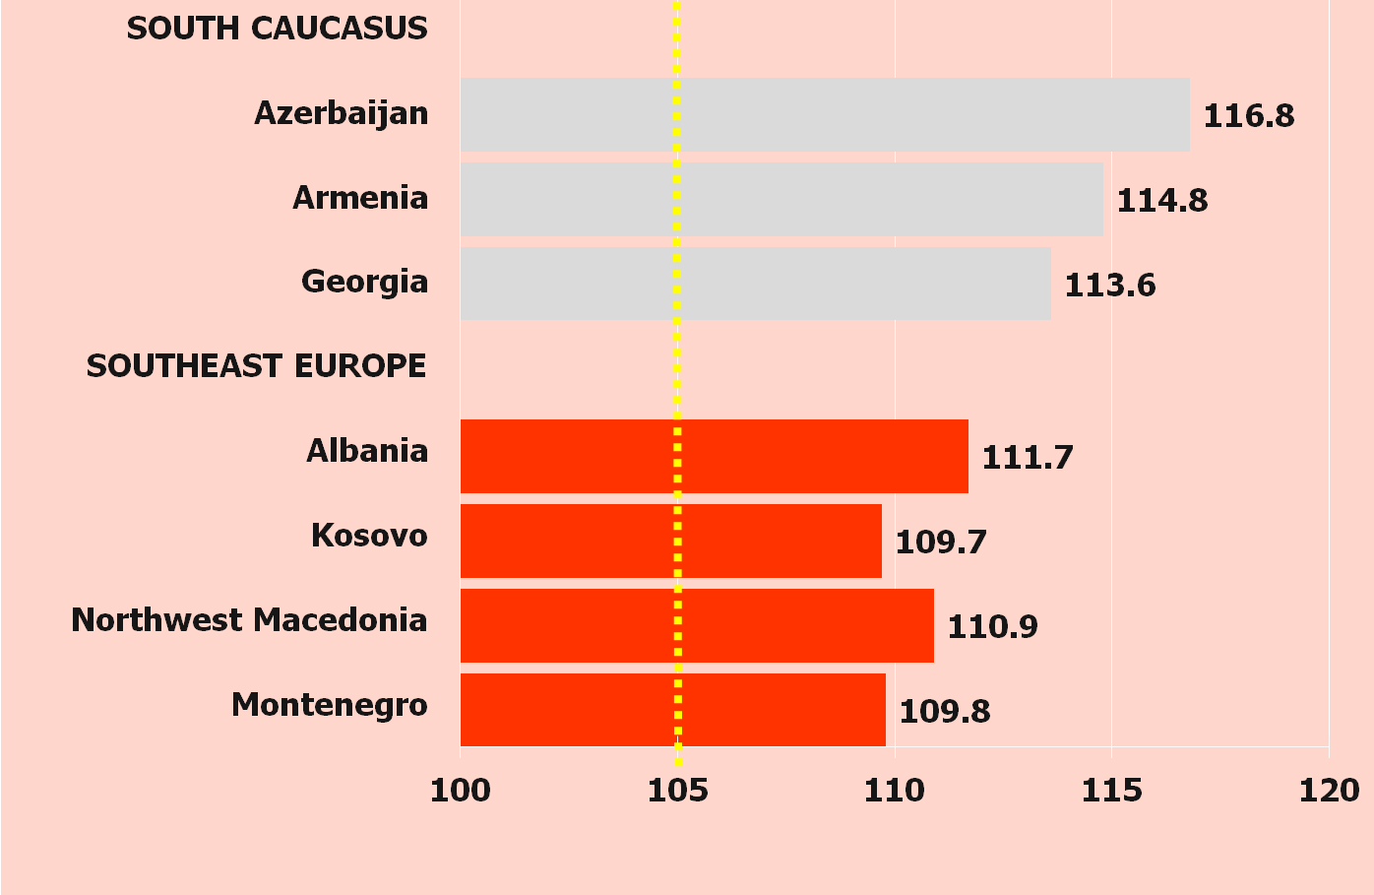
TRADITION versus DEVELOPMENT
a new phenomenon ... sex imbalances at birth

Slide 26
TRADITION versus DEVELOPMENT
a new phenomenon ... sex imbalances at birth
Why is it happening now?
Three pre-conditions:
It is “desirable” – son preference is some regions of the World
It is “possible” – access to new technology (sex selective abortion)
It is “necessary” – the effect of fertility decline

Slide 27
TRADITION versus DEVELOPMENT
a new phenomenon ... sex imbalances at birth
Were we able to predict it?
Excess female mortality?
Not Universal
E.g. Not found in Vietnam, but found in India, Albania etc.
Patriarchy – son preference
This is universal – most societies have some form of son preference, either through religion or through cultural believes.

Slide 28
TRADITION versus DEVELOPMENT
a new phenomenon ... sex imbalances at birth
Sex ratio at birth in rural and urban areas of Albania, 1950-2010
SOURCE: Based on Vital Registration data

Slide 29
TRADITION versus DEVELOPMENT
a new phenomenon ... sex imbalances at birth
Sex ratio at birth by birth parity, 1995-2010
SOURCE: Based on Vital Registration data

Slide 30
TRADITION versus DEVELOPMENT
a new phenomenon ... sex imbalances at birth
Sex ratio at birth by parental education, 1995-2010
SOURCE: Based on Vital Registration data

Slide 31
TRADITION versus DEVELOPMENT
Transition to market economy (1990 …..)
Concluding note:
It seems that "traditionalism" or "norms" persisted for the onset of family formation, and sex selection at birth, whereas perhaps “modernity” and economic constraints impacted the number of children one has in Albania

Slide 32
TRADITION versus DEVELOPMENT
Transition to market economy (1990 …..)
Concluding Remarks:
Investment in the social agenda, with particular focus on female education and employment had a dramatic effect on fertility reduction in Albania, despite a pro-natalist environment and in the absence of contraception and abortion
While development via education seems to be the main factor in bringing fertility down, the norms that maintained fertility within marriage seem to persist in determining the family structures and sex selection at birth
How come that these policies did not affect the family formation, in particular the marriage pattern the same way as fertility? How come the most educated applied the most the sex selection at birth? Is there anything else to explain this ‘paradox’?

Slide 33
TRADITION versus DEVELOPMENT
norms versus ideas
Development Idealism models (Arland Thornton, 2001, 2007)
Development Paradigm:
A model of societal change that suggests that all societies progress through the same natural, universal and necessary stages of development.
Scholars developing this model looked at the cross-sectional variation of societies and try to interpret the trajectories of development – ‘reading history sideways’
They observed that family systems of North-west Europe were different to the rest of the world (e.g. marriage pattern, fertility patterns, gender roles, patterns of leaving home, living arrangements etc.)
… and that development is a trajectory from the traditional, patriarchal norms seen outside of north-western Europe to developed values seen in North-western Europe.
These development paradigm does not represent just an idea or an approach in social science, but a strong model of development – Developmental Idealism (by Thorton, A. 2001).

Slide 34
TRADITION versus DEVELOPMENT
norms versus ideas
What is Developmental Idealism? (Arland Thornton, 2001, 2007)
Developmental Idealism includes a set of ideas identifying goals in life, a means for evaluating various forms of human organisation, an explanatory framework identifying the casual influences between family and social and economic life….#
There are four main propositions of Developmental Idealism:
Modern society is good and attainable
Modern family is good and attainable
Modern family is a cause and an effect of modern society
Individuals have the right to be free and equal and have their social relationship based on consent

Slide 35
TRADITION versus DEVELOPMENT
norms versus ideas
New data on ideas, norms, fertility and marriages in Albanian (MICS3)
Three modules were introduced in the MICS3 Albania survey:
Developmental ideas (men and women 15+)
The values and attitudes (men and women 15 +)
A complete fertility and marriage history (women 15 years older)
The data asked both men and women of 1200 households, about 3384 individuals (a sub-sample of the MICS3 survey) – national representative, stratified for urban and rural areas.

Slide 36
TRADITION versus DEVELOPMENT
norms versus ideas
Results of the family change and development
People’s view on development and family formation
Table a
Gjonca and Thornton, 2016

Slide 37
TRADITION versus DEVELOPMENT
norms versus ideas
Results of the family change and development
People’s view on development and family formation
Table b
Gjonca and Thornton, 2016

Slide 38
TRADITION versus DEVELOPMENT
norms versus ideas
Results of the family change and development
People’s view on development and family formation
Table c
Gjonca and Thornton, 2016

Slide 39
TRADITION versus DEVELOPMENT
norms versus ideas
Initial remarks on family formation, development, ideas and norms
Albanians have considerable knowledge of development and see a strong association between socio-economic development and family formation
They also perceive development as influential in determining the future pattern of their fertility and to some extend marriage
Albanians see low fertility but not an older age at marriage as being an important causal force in producing economic growth
At this stage we can only hypothesize that the beliefs about low fertility being a causal influence on economic growth could help explain the decline in fertility, while the lack of belief in a high age at marriage being a factor in economic growth could help explain the relative stability in age at marriage

Slide 40
TRADITION versus DEVELOPMENT
norms versus ideas
What next in terms of research?
An opportunity to test what predicts better marriage and fertility in the Albanian population, IDEAS or NORMS, based on this data set

